Slide 1
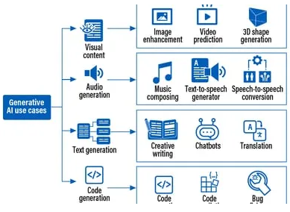
.Generative AI is a cutting-edge technology that’s transforming the way we create and interact with content. It’s type of artificial intelligence that can create new content, such as text, images, music, video or code. It learns patterns from massive amounts of data and then generates similar content. Think of it as a creative AI assistant that can write stories, design artwork, or compose music.
Generative AI is largely derived from advancements in machine learning. Specifically, it builds upon Neural Networks, Deep Learning, Natural Language processing, Computer Vision. These foundational technologies have evolved over decades, but their convergence and application to generating new content have led to the rapid growth of generative AI.
RAG (Retrieval Augmented Generation) is transforming industries by providing access to relevant information and generating human-quality text formats. Here are some key industrial use cases:
Industrial Use Cases:
Internal Search: Enabling employees to find relevant information within the Companies data.
Document Summarization: Generating concise summaries of lengthy documents
Legal Research: Analyzing case law and statutes to support legal arguments. Extracting
key information from legal documents.
Product Recommendations: Suggesting products based on customer behavior and preferences.
Human Resources: Screening resumes, generating job descriptions, and providing emp support.
Fraud Detection: Identifying fraudulent activities by comparing data against known patterns.
Music Composition: Generating original music, unique sound effects for films and TV shows.
Video Editing: Automating tasks like color correction, noise reduction, and object removal

Slide 2
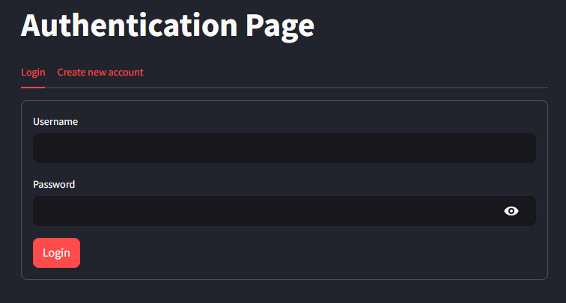
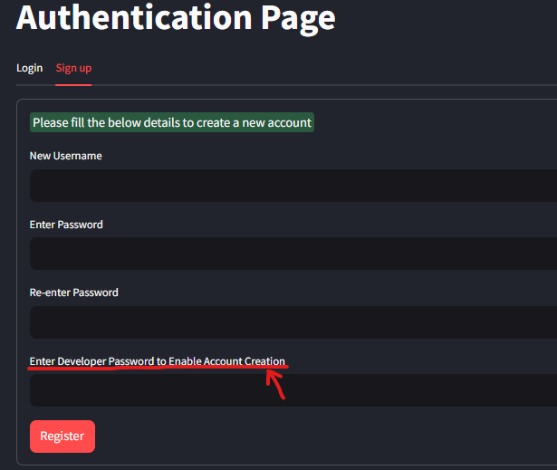
Generative AI Apps
PDF Query Bot Authentication Page:
URL for access application : https://pdfquerybot.chola.murugappa.com/
Credentials for access : (username/ password) : treasury / C######3
Login Page :
Once you visited the above mentioned website from any browser will get you
To login page, where it will ask your team credentials like username and password.
Please enter your credentials and click the login button.
Create new account Page :
If your team does not yet have an account, click on the “Sign up" tab as shown in the image.
You will be directed to the account creation page where you must enter the following details:
Username: Use your Team Name
Password: Set a secure password for your team account
Developer Password: only Risk team member who maintain this app have access for developer,
To create a new account contact the Risk team- Saroja
Important Note:
Don’t create new account for individual users. Please create one account for one entire team. This is because Google Vision OCR usage costs for Image PDF’s are tracked and billed per team,
based on their usage.

Slide 3
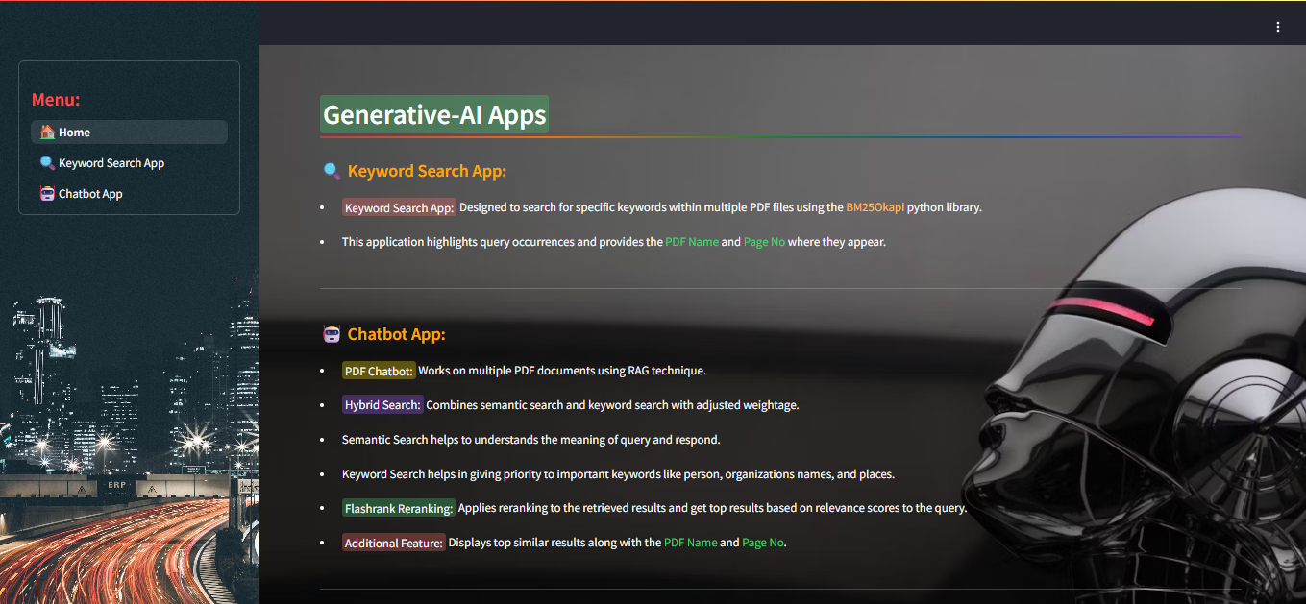
Generative AI Apps
Overview of Generative AI Applications:
Upon logging into the application, you will be directed to the home page. the home page features a menu bar on the left and an introduction to the Keyword Search and QA Chatbot applications.
Keyword Search App: Once you click the Keyword search App button, it will land you in the respective page, where you can upload the multiple scanned or normal PDF’s. based on the Keywords you are querying, the application will display relevant PDF file names and page numbers, highlight the queried keywords within the text for easy visibility.
QA Chatbot App: Once you click the Chatbot App button, will get you into the respective page Where you can upload the PDF’s and you can chat with application by asking your query related to that PDF, It will give you the fine and precise answer based on question.

Slide 4
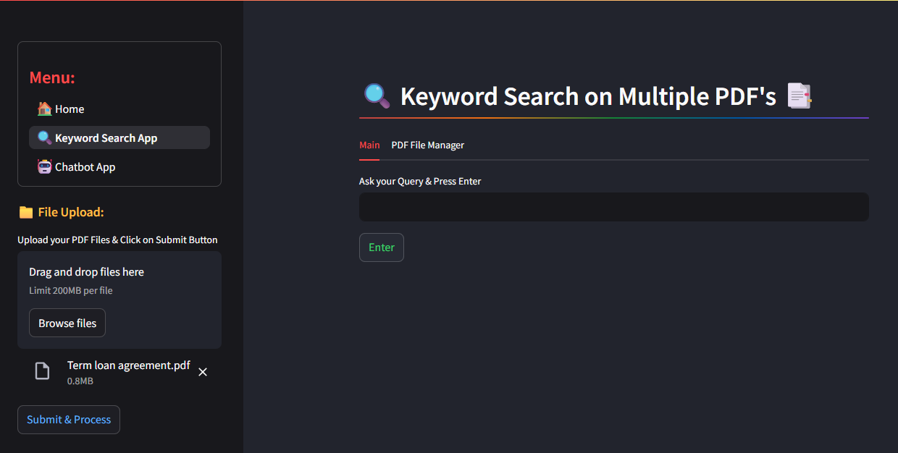
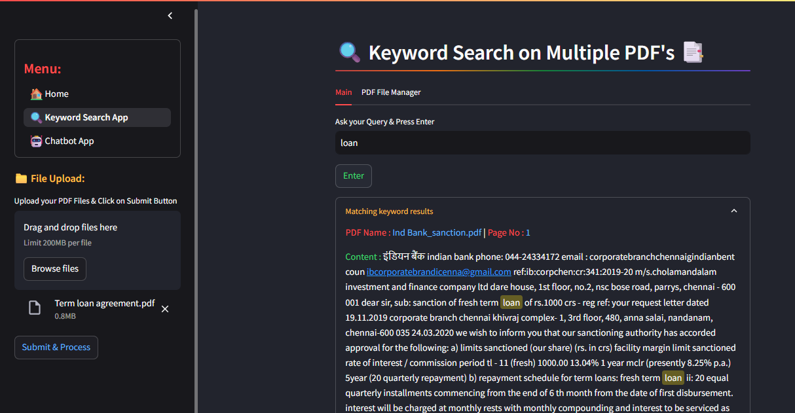
Keyword Search App
Steps to follow :
Step:1 Upload the PDF’s you wish to keyword search by clicking the “Browse Files” button on left side tab. After selecting the files, click “Submit & Process” button.
(Note: Please upload only 10–20 PDFs at a time. The application is hosted on an on-premise server; uploading more may cause server issues.)
Step:2 Once file uploaded, Google Vision OCR is used to extract text from scanned PDF’s, Langchain PyPDFLoader is used for normal (text-based) PDFs. Extracted content from image PDF’s is stored in MongoDB, acting as the application’s storage. Based on the number of files you have uploaded this step will take few mins to process, so wait patiently.
“Files successfully loaded” message will appear upon completion.
(Note: If you are trying to upload the already processed files, It will not be processed. App reuses the content from the existing storage to save OCR processing costs.)
Step:3 Enter your keyword in the textbox on the right side and press “Enter” button.
Step:4 Matching results of Keywords found in the documents will be highlighted in yellow for easy visibility, the result will include the details of PDF file name and Page no, where the keyword appears, scroll down to see all the results.

Slide 5
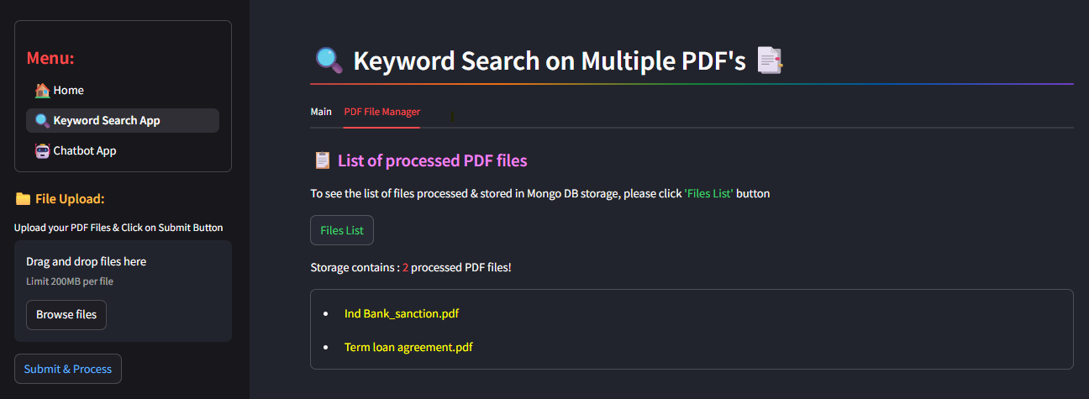
Keyword Search App – File Manager Features
Accessing Uploaded PDF Files :
To view the list of previously uploaded and processed PDF files in the Keyword Search application:
Click on the “PDF File Manager” tab, as highlighted in the image. This will navigate you to the File Manager page.
On the File Manager page, click the “File List” button to display the complete list of available files.

Slide 6
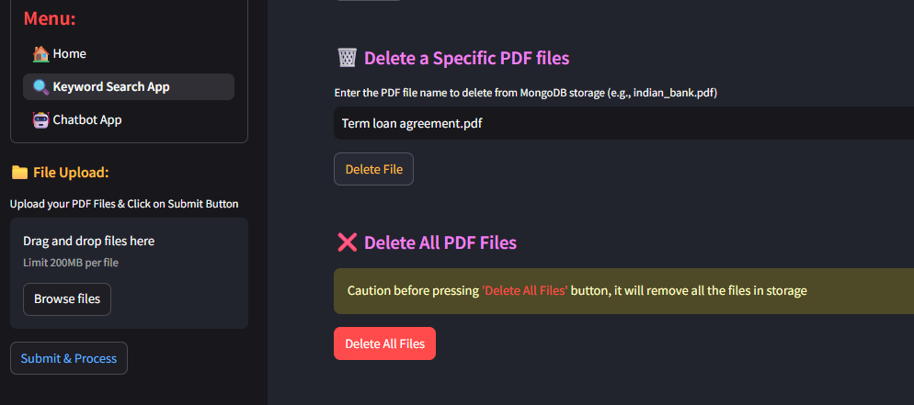
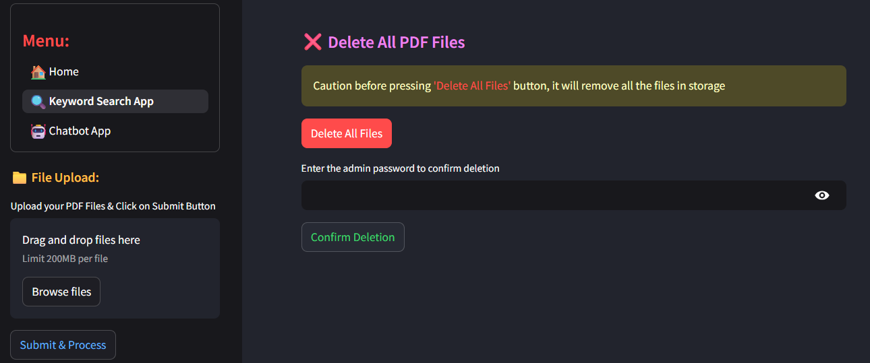
Keyword Search App – File Manager Features
Deleting a Specific PDF File :
If you have accidentally uploaded a PDF or no longer require a particular file, you can remove its content from the MongoDB storage:
Click on the “PDF File Manager” tab, to navigate you to the File Manager page.
In the “Delete a Specific PDF files” section, Enter the PDF file name in the provide
text box. then click the “Delete File” button to permanently delete the associated content
from MongoDB storage.
Deleting All PDF Files from Storage:
If the extracted information from all Image PDF files is no longer required, you can delete the entire dataset to free up MongoDB storage and enhance future search performance.
Click on the “PDF File Manager” tab, to navigate you to the File Manager page.
In the “Delete All PDF files” section, click the “Delete All Files” button.
When prompted, enter the Admin Password in the provided text box to authorize
the deletion. For Admin password ask Risk team member who maintains this app.
Click the “Confirm Deletion” button to permanently remove all content from storage.
⚠️ Note: This action is irreversible.

Slide 7
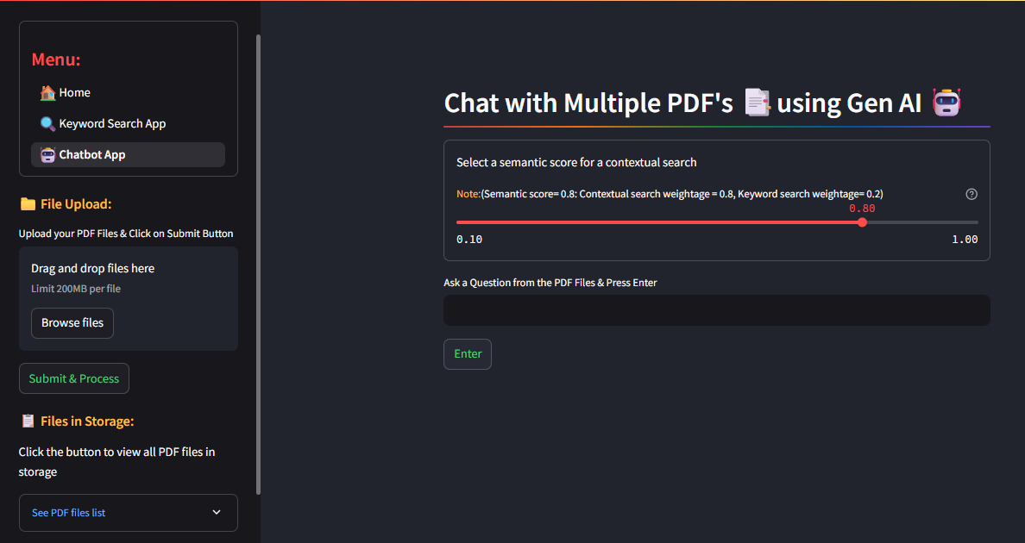
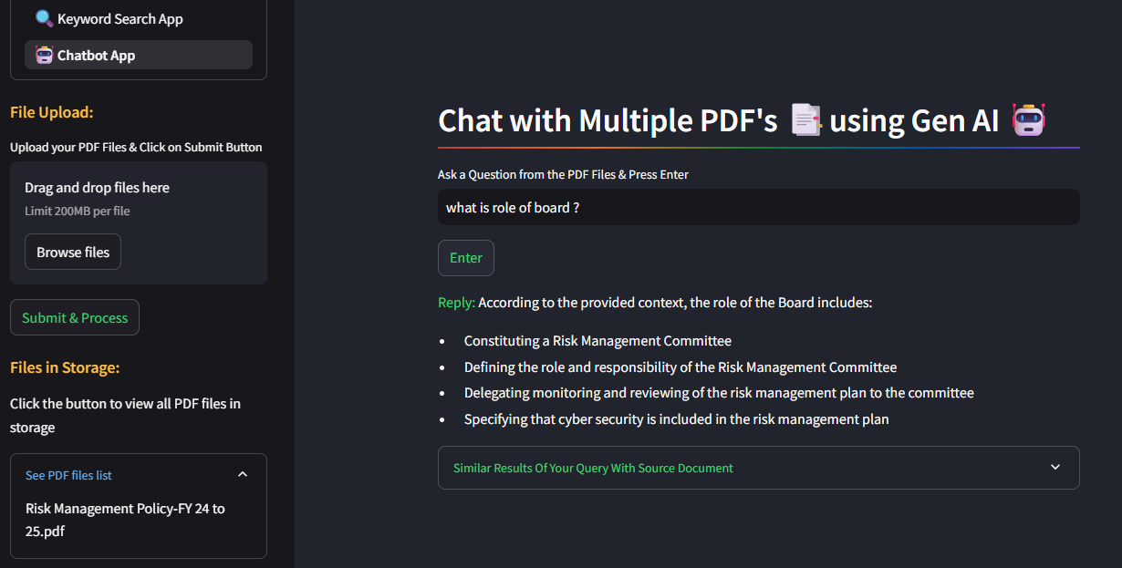
QA Chatbot App
Steps to follow :
Step:1 Click the “Browse Files” button to upload the PDFs you want to use for question answering. After selecting the files, click “Submit & Process” to begin.
Step:2 Once uploaded, Google Vision OCR is used to extract text from scanned PDFs, Langchain PyPDF Loader is used for normal (text-based) PDFs. Extracted content is split into multiple chunks and stored as embeddings in a FAISS vector database. which act as the application’s storage. “Files successfully loaded” message will confirm the upload and processing is complete.
Step:3 Enter your question you want to ask in the textbox on the right side and press the “Enter” key to submit your query.
Step:4 Choose an appropriate Semantic score to do Contextual search, higher the score prioritize the Contextual search, lower the score for Keyword based search.
Step:5 Question will be converted into embeddings and similarity search is performed in the vector database to retrieve relevant content. Reranked retrieved contexts are passed to the LLM to generate a precise and fine results.
Step:6 To see the source PDF files used to answer your question, click the button “Similar results of your Query with Source Documents”. the result will include the details of PDF file name and Page no, where the relevant content appears. The matched keywords will be highlighted in yellow for easy identification yellow in colour, scroll down to see all the results.

Slide 8
RAG- Retrieval Augmented Generation
RAG QA Chatbot is designed to provide accurate and contextually relevant answers by combining retrieval and generation mechanism. It has following workflows.
Step:1 Ingesting the data file(pdf, text, ppt etc)
Step:2 Extracting the text from file using Python library’s or OCR to extract the text from Images & Image pdf
Step:3 Splitting the extracted text to small chunks of text for more precise matching with user’s query, more computationally efficient.
Step:4 Using Embeddings to convert the text chunks into embedded vector and store them in Vector DB.
Step:5 When user asks a query will convert those query into embedding and pass them into Vector DB for similarity and keyword text retrieval using retriever from knowledge base.
Step:6 Once retrieved multiple chunks of text will pass it to LLM
model for generate the fine and robust output for user query

Slide 9
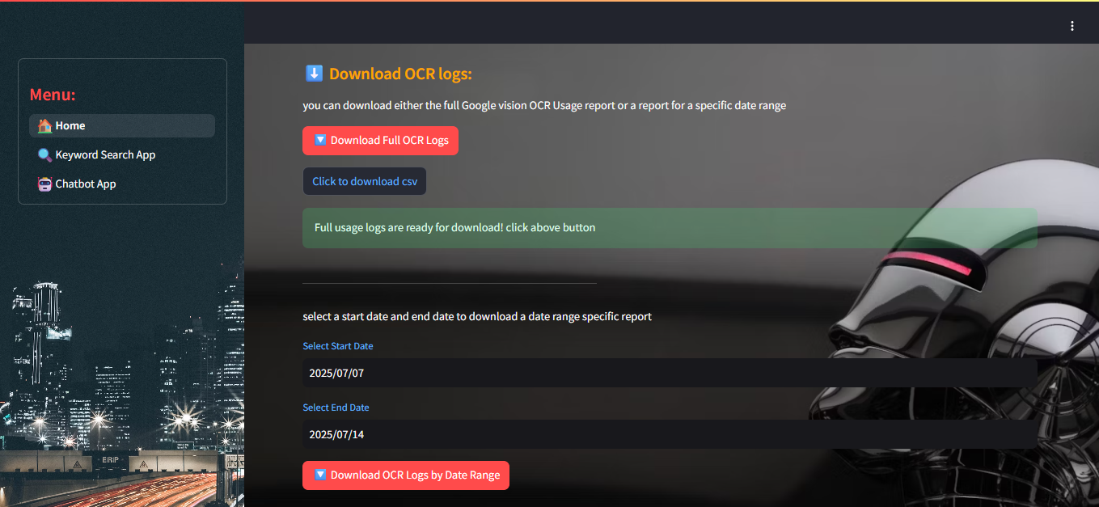
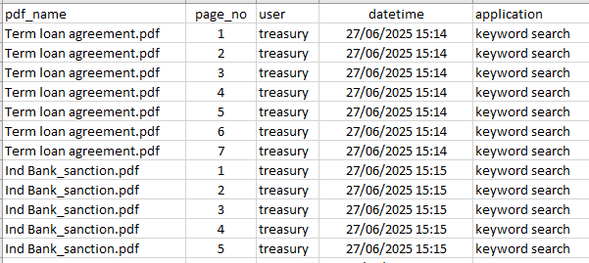
Downloading Google Vision OCR Usage Logs
Download OCR Logs :
To review the usage of Google Cloud Vision OCR for extracting text from scanned PDF files:
Navigate to the Home page and scroll down to the bottom section.
You will find two options:
Download Full OCR Logs (from the beginning to the current date)
Download OCR Logs by Date Range (for a specific date range)
3. To download the complete usage report:
Click the “Download Full OCR Logs” button. This will retrieve the OCR usage data from MongoDB.
Once processed, click the “Click to Download CSV” button to download the report.
The downloaded Excel file includes information like
List of processed PDF files,
User information (who accessed the OCR service)
Date of processing,
Application used for processing

Slide 10
Google Cloud Vision OCR
OCR- Optical Character Recognition used to convert into searchable or extract content from scanned paper documents, PDF or Images.
Google Cloud Vision OCR is used to detect and extract text and structure (tables, titles, paragraphs, selection marks) from Images, scanned documents using OCR which is a Deep Learning- Computer Vision technology
Pros: Paid OCR’s are Fast and accurate in Text Extraction from Image documents compare to open source OCR, which is lag in accuracy, data loss
and slow in extracting texts.
Costing Link : Google Cloud Vision OCR Costing
Feature | First 1000 units/month | Units 1001- 5,00,000 /month | More than 5,00,001/ month
Text Detection | Free | $ 1.50 | $ 0.60
Document Text Detection | Free | $1.50 | $0.60

